Slide 1


The analysis of a two-phase experiment involving human subjects using ASReml-R & asremlPlus
Chris Brien UniSA STEM, University of South Australia
Australian Plant Phenomics Facility, University of Adelaide.

Slide 2
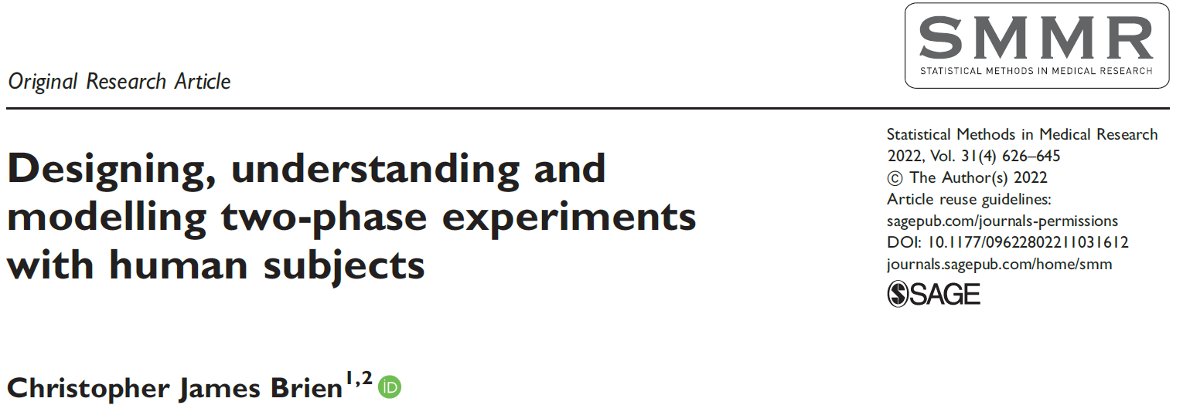
Outline
A two-phase pain-rating experiment.
Linear mixed model analysis.
Get and plot predictions based on chosen model
Conclusions.

Slide 3
1. A two-phase pain rating experiment (Solomon et al., 1997; Farewell & Herzberg, 2003, Jarret et al. (2020), Brien (2022)
Self-assessment phase:
8 patients, 4 judged to be expressive and 4 unexpressive.
Each patient is to undergo a movement on each of 2 occasions.
Two motions allocated to the occasions: active and passive motion performed without and with assistance.
For clinical reasons, always active then passive.
The outcomes are:
16 videos for 8 patients × 2 Occasions;
A pain rating by each patient on each occasion.
2 Expressiveness
4 Patients in E
2 Occasions
2 Motions
2 motions
16 videos

Slide 4
Two-phase pain rating experiment (cont’d)
Evaluation phase:
74 Raters (occupational and physical therapy students) rate pain using the videos from the first phase.
Half of the raters were randomly chosen to be trained in identifying pain from facial movements, and the other half were untrained.
Each rater rated the 16 videos, in the same order at 16 viewings.
The outcome of this phase is the set of 16 differences between patient and rater scores for each rater.
2 trainings
2 Trainings
2 Expressiveness
4 Patients in E
2 Occasions
74 Raters
16 Viewings
2 Motions
2 motions
16 videos
1184 episodes

Slide 5
2. Linear mixed model analysis
2 trainings
2 Trainings
2 Expressiveness
4 Patients in E
2 Occasions
74 Raters
16 Viewings
2 Motions
2 motions
16 videos
1184 episodes
Model based on allocations; terms derived from factors in panels.
Suppose any term involving some combo of T, M or E is to be assumed fixed and the rest are random.
Random model:
Mean + R + V + R:V + O + O:E + E:P + O:E:P.
Fixed model – all interactions for T, M & E:
Mean + T + M + T:M + E + T:E + M:E + T:M:E.
But random model is singular:
M ≡ O and M:E ≡ O:E; V and O:E:P inseparable.
Nonsingular random model:
Mean + E:P + R + V + R:V.

Slide 6
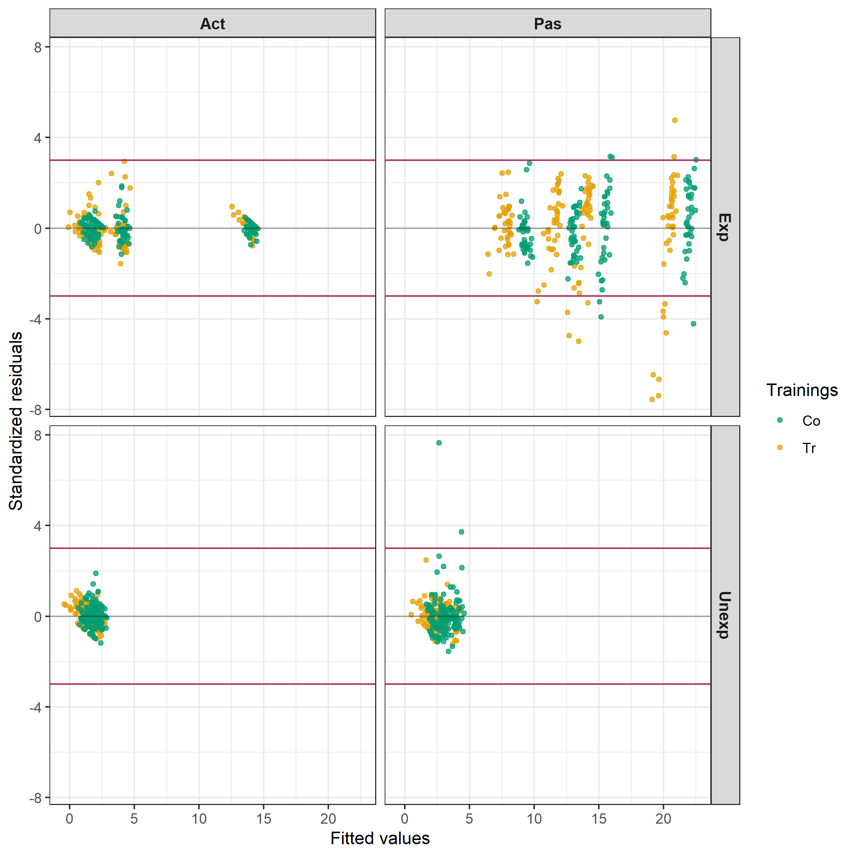
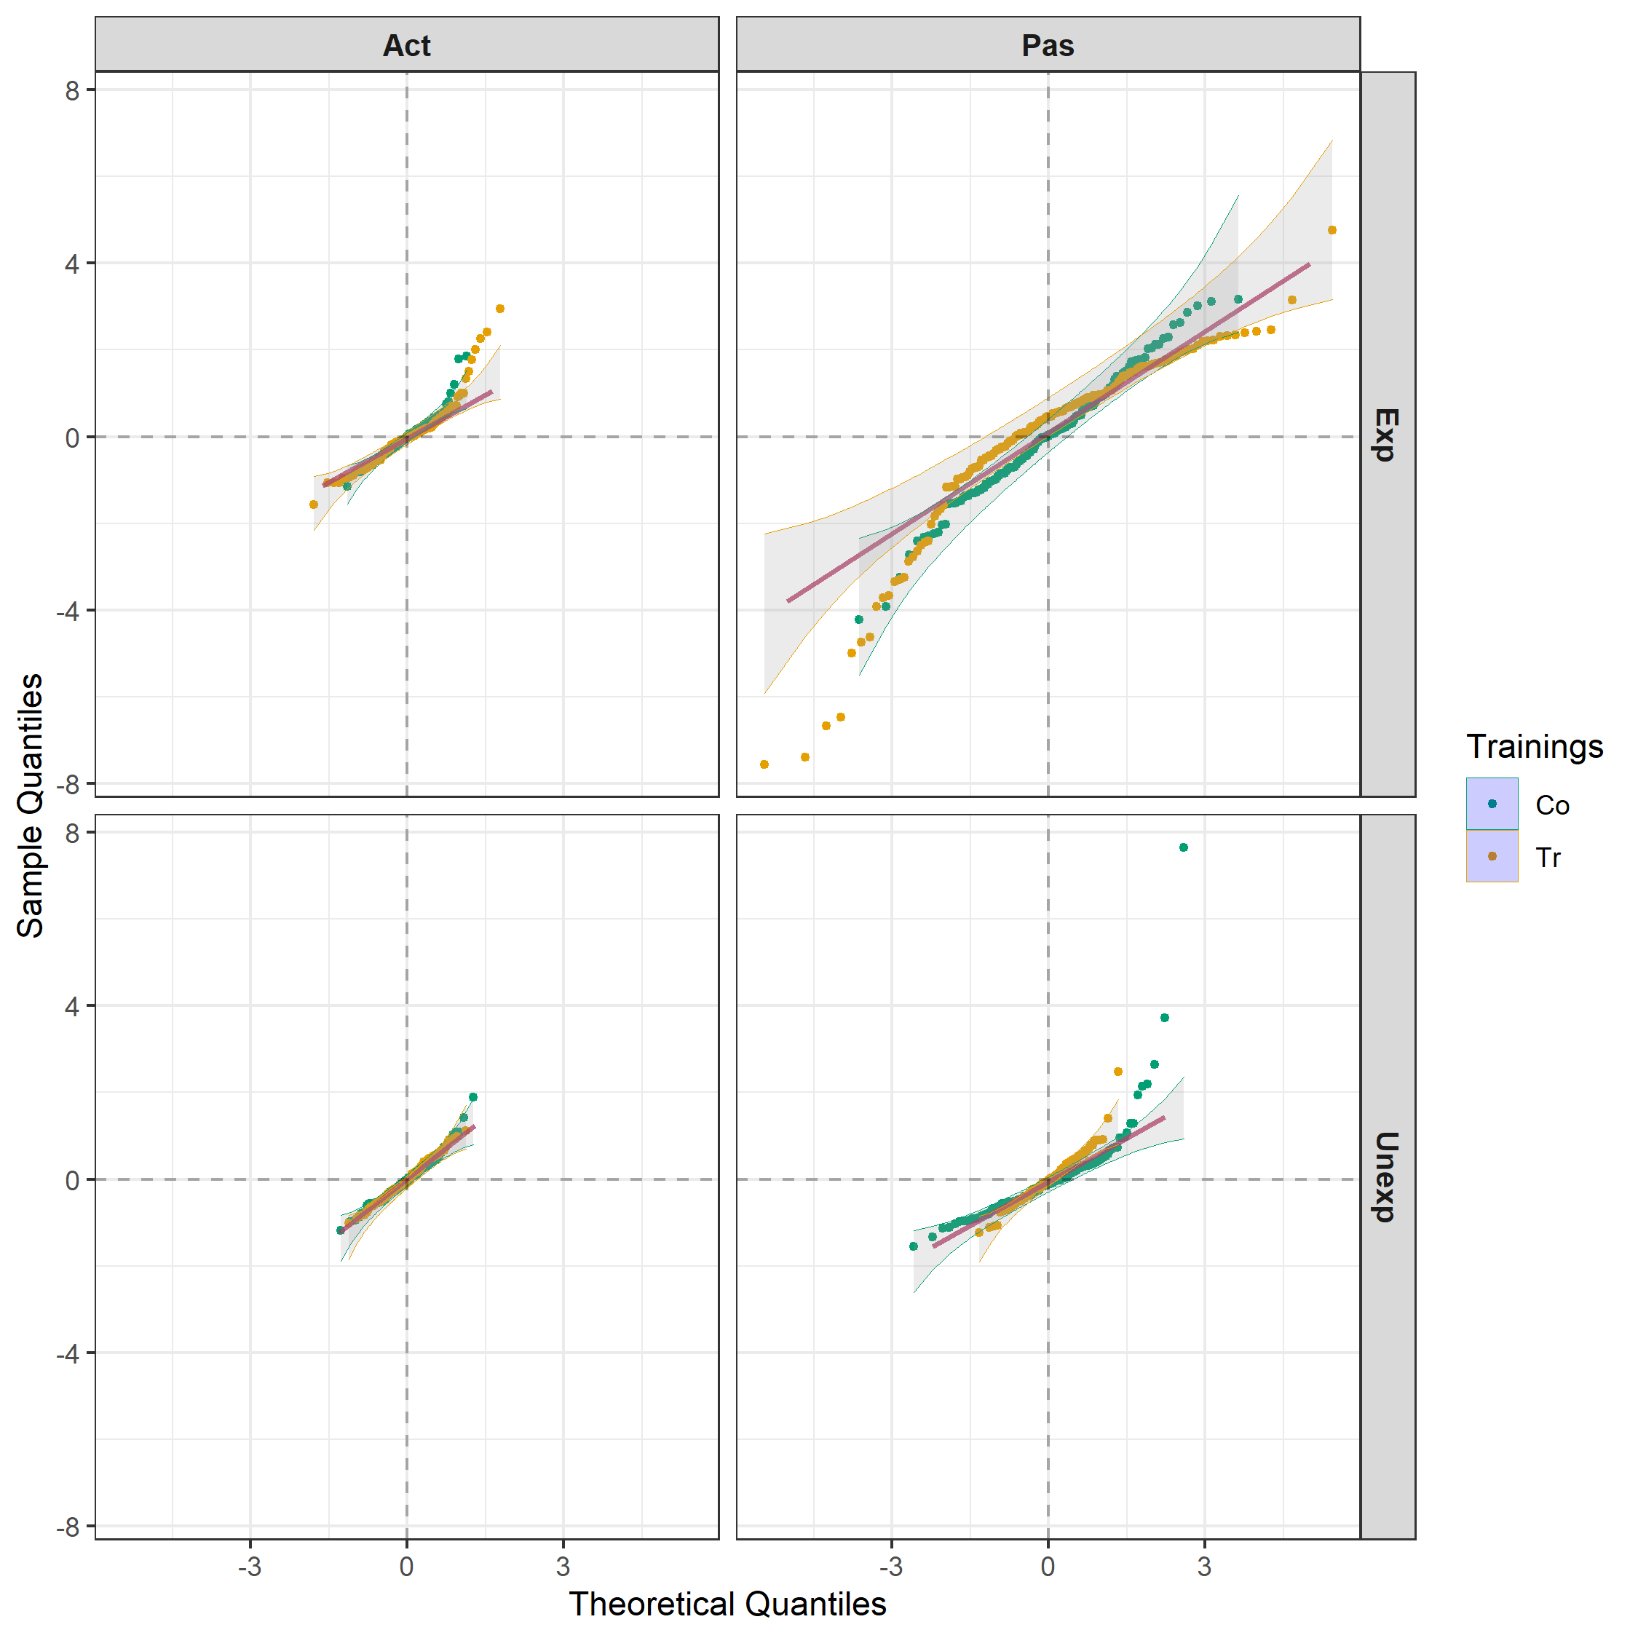
Linear mixed model (LMM) analysis
The LMM T*M*E | E:P + R + V + R:V is fitted using asreml (Butler et al., 2020).
Clear evidence of unequal variances and nonnormality.

Slide 7
Including intertier (block-treatment) interactions
2 trainings
2 Trainings
2 Expressiveness
4 Patients in E
2 Occasions
74 Raters
16 Viewings
2 Motions
2 motions
16 videos
1184 episodes
Jarrett, Farewell & Herzberg (2020) showed, using the published data, that random block-treatment interactions occurred in this case.
The intertier interactions are all terms involving factors from different panels,
except that interactions between a factor and the factor(s) to which it is allocated are unable to be estimated due to a lack of replication.
e.g. Trainings and Raters, for which there is only one training for each rater.
Random model (5 of the 6 panel-pairs):
E:P + R + V + R:V + (T * M):P:E + T:V + R:M + R:O * (E / P)).
Four models (a-d) were fitted using ASReml-R and asremlPlus:
± intertier interactions, ± heterogeneous variances
Model d) lowest AIC.
Same intertier interactions as J, F & H.

Slide 8
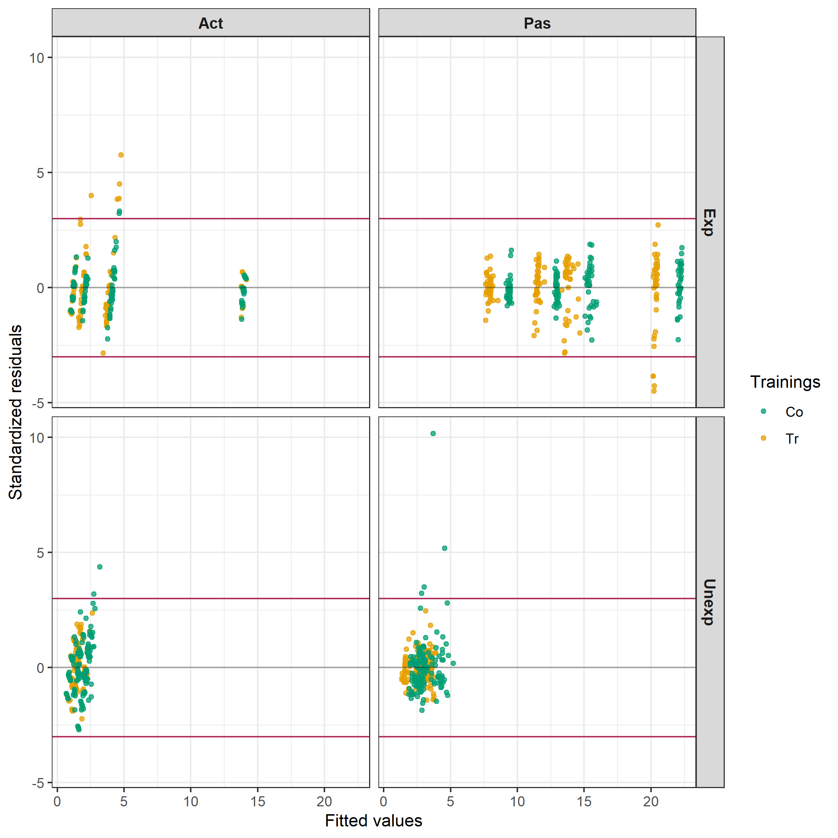
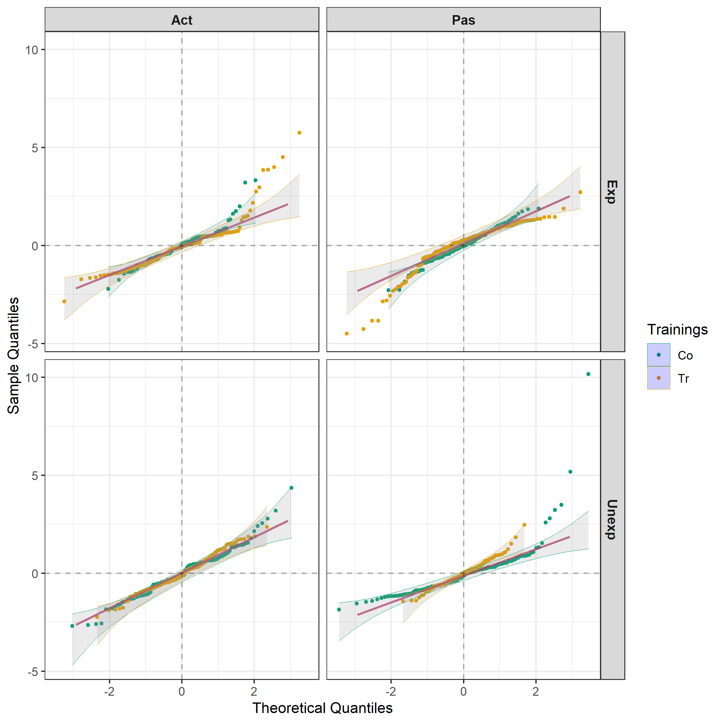
Residuals under model d) intertier interaction & unequal Motion-Expressiveness variances
Evidence of outliers, but approximately homogeneous.

Slide 9
3. Get and plot predictions based on model d) using ASReml-R and asremlPlus
#### Pseudo-anova table for fixed terms
Wald tests for fixed effects.
Response: Y
Df denDF F.inc Pr
(Intercept) 1 6.0 18.070 0.0054
Trainings 1 9.2 6.895 0.0271
Motions 1 5.9 65.700 0.0002
Trainings:Motions 1 11.9 2.577 0.1346
Expressiveness 1 6.0 7.088 0.0374
Trainings:Expressiveness 1 9.9 0.324 0.5821
Motions:Expressiveness 1 5.9 39.300 0.0008
Trainings:Motions:Expressiveness 1 27.5 5.427 0.0274

Slide 10
3. Get and plot predictions based on chosen model
Use predictPlus from asremlPlus, that employs predict from ASReml-R, to produce predictions with half-LSD intervals (LSIs).
Problem: the variances differ between Motions and Expressiveness combinations.
Base LSIs on LSDs for comparing within each combination.
md.byME.diffs <- predictPlus(md.asr, classify = "Trainings:Motions:Expressiveness",
error.intervals = "halfLeast", LSDtype = "factor.combin",
LSDby = c("Motions","Expressiveness"),
wald = md.AIC.asrt$wald.tab,
Vmatrix = TRUE, tables = "none")
alldiffs object:
stores predictions (with intervals), vcov, differences, p.differences, sed, LSD, backtransforms.

Slide 11
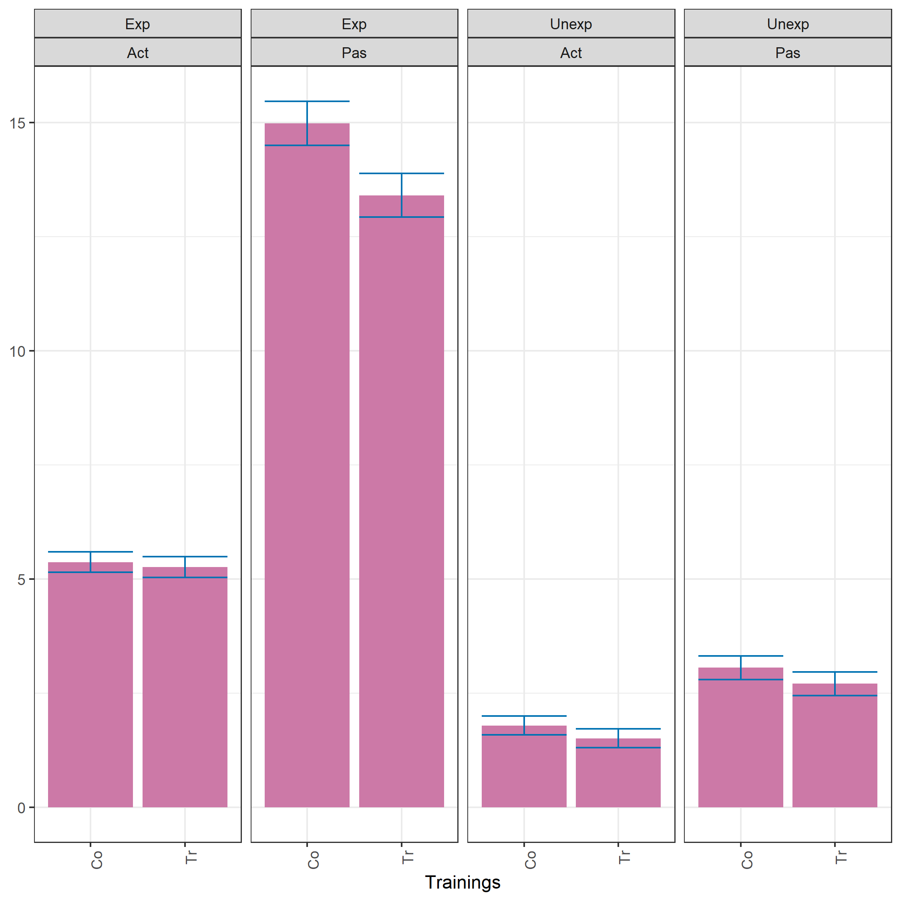
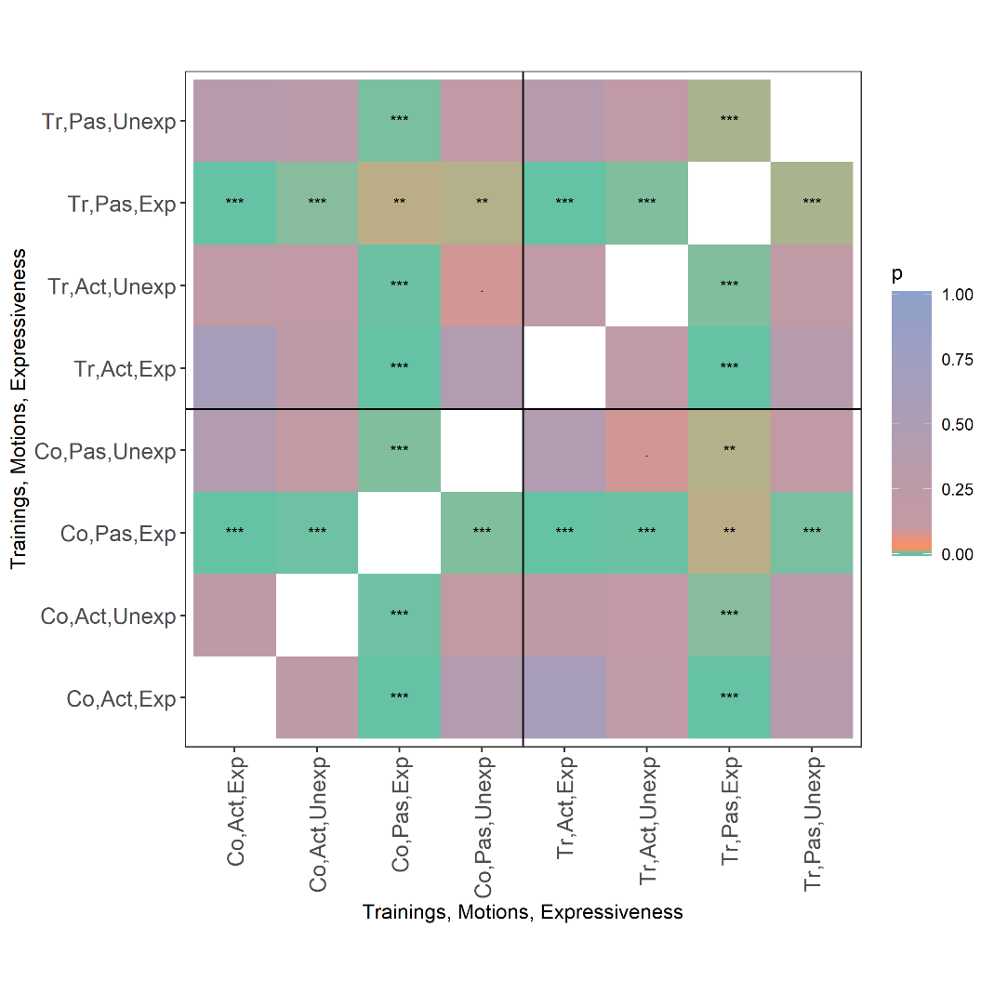
Predictions
Note the differences in LSD values, due to unequal variances.
plotPvalues(md.byME.diffs,
factors.per.grid = 2,
show.sig = TRUE)

Slide 12
Explore the overall LSIs using exploreLSDs
Aim to find a single LSD value for which:
there are no false results and, if no such value exists, find one for which: (i) the number of false positives is minimized, and (ii) amongst those minimizing the false positives, the smallest value that minimizes the number of false negatives.
Use asremlPlus function exploreLSDs to investigate potential values:
exploreLSDs(md.byME.diffs)
#### Statistics calculated from LSD values
c min quant10 quant25 mean median quant75 quant90 max
1 28 0.4122667 0.8253761 1.776596 4.516005 5.807641 5.838427 5.842495 5.84253
#### False positives resulting from the use of various LSD statistics
c min quant10 quant25 mean median quant75 quant90 max
false.pos 28 12 12 8 0 0 0 0 0
#### False negatives resulting from the use of various LSD statistics
c min quant10 quant25 mean median quant75 quant90 max
false.neg 28 0 0 1 1 1 1 1 1
The asremlPlus function pickLSDstatistics automates this selection.

Slide 13
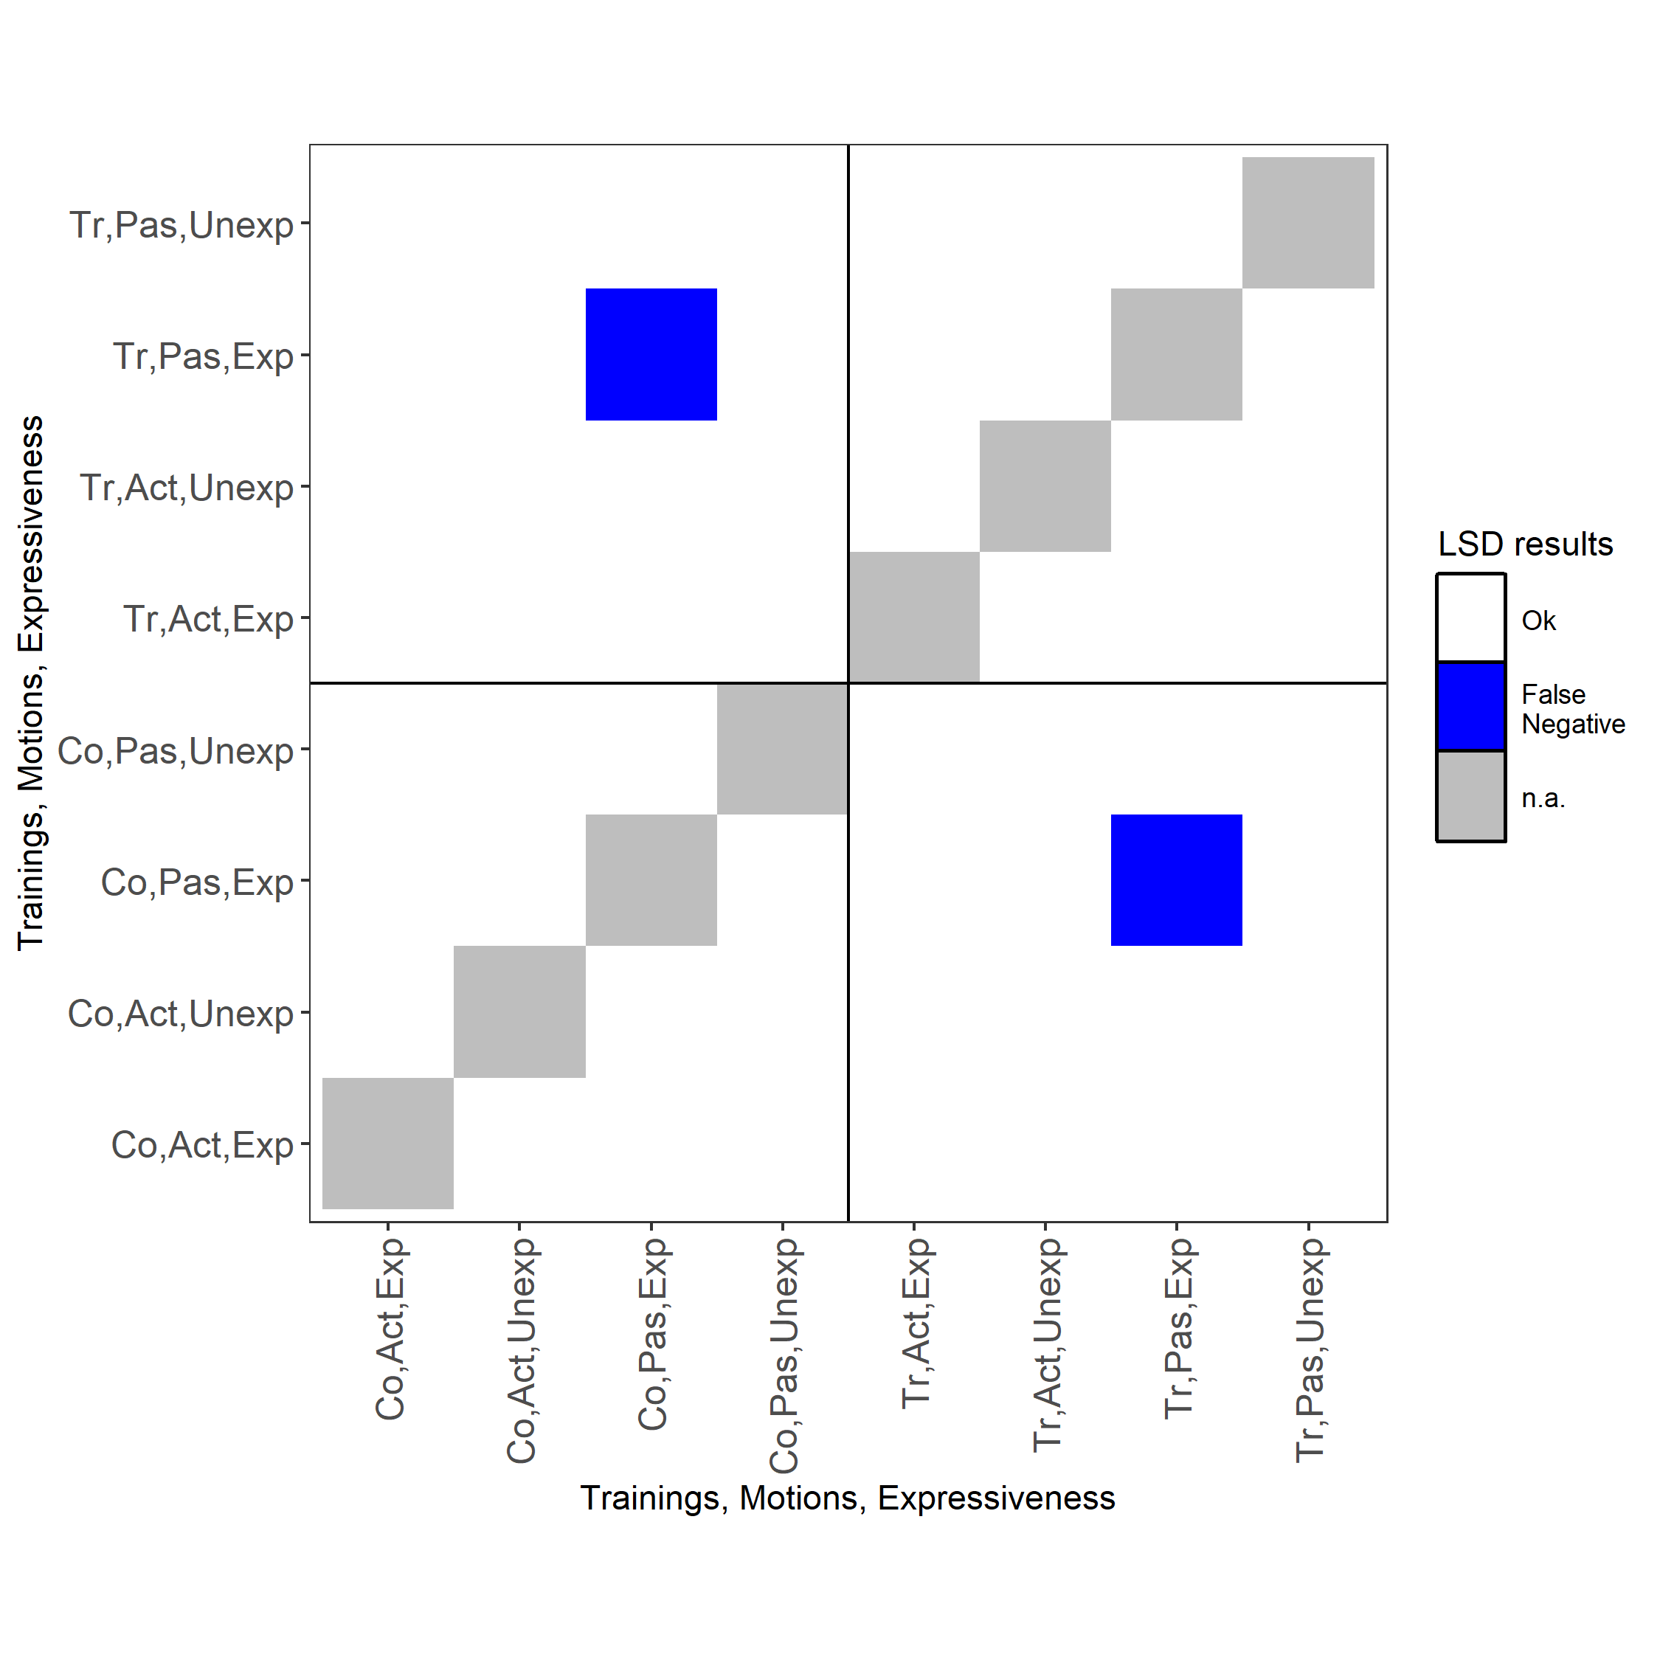
Explore the overall LSIs
Calculate LSIs for all differences based on mean LSD.
md.LSDmn.diffs <- redoErrorIntervals(md.byME.diffs, error.intervals = "half",
LSDtype = "overall", LSDstat = "mean",
avsed.tolerance = NA,
wald = md.AIC.asrt$wald.tab)
plotLSDerrors(md.LSDmn.diffs,
factors.per.grid = 2,
show.sig = TRUE)
### Copy LSIs for within Exp, Pas
preds <- md.LSDmn.diffs$predictions
preds[preds$Motions == "Pas" & preds$Expressiveness == "Exp",] <-
with(md.byME.diffs$predictions,
md.byME.diffs$predictions[Motions == "Pas" &
Expressiveness == "Exp",])

Slide 14
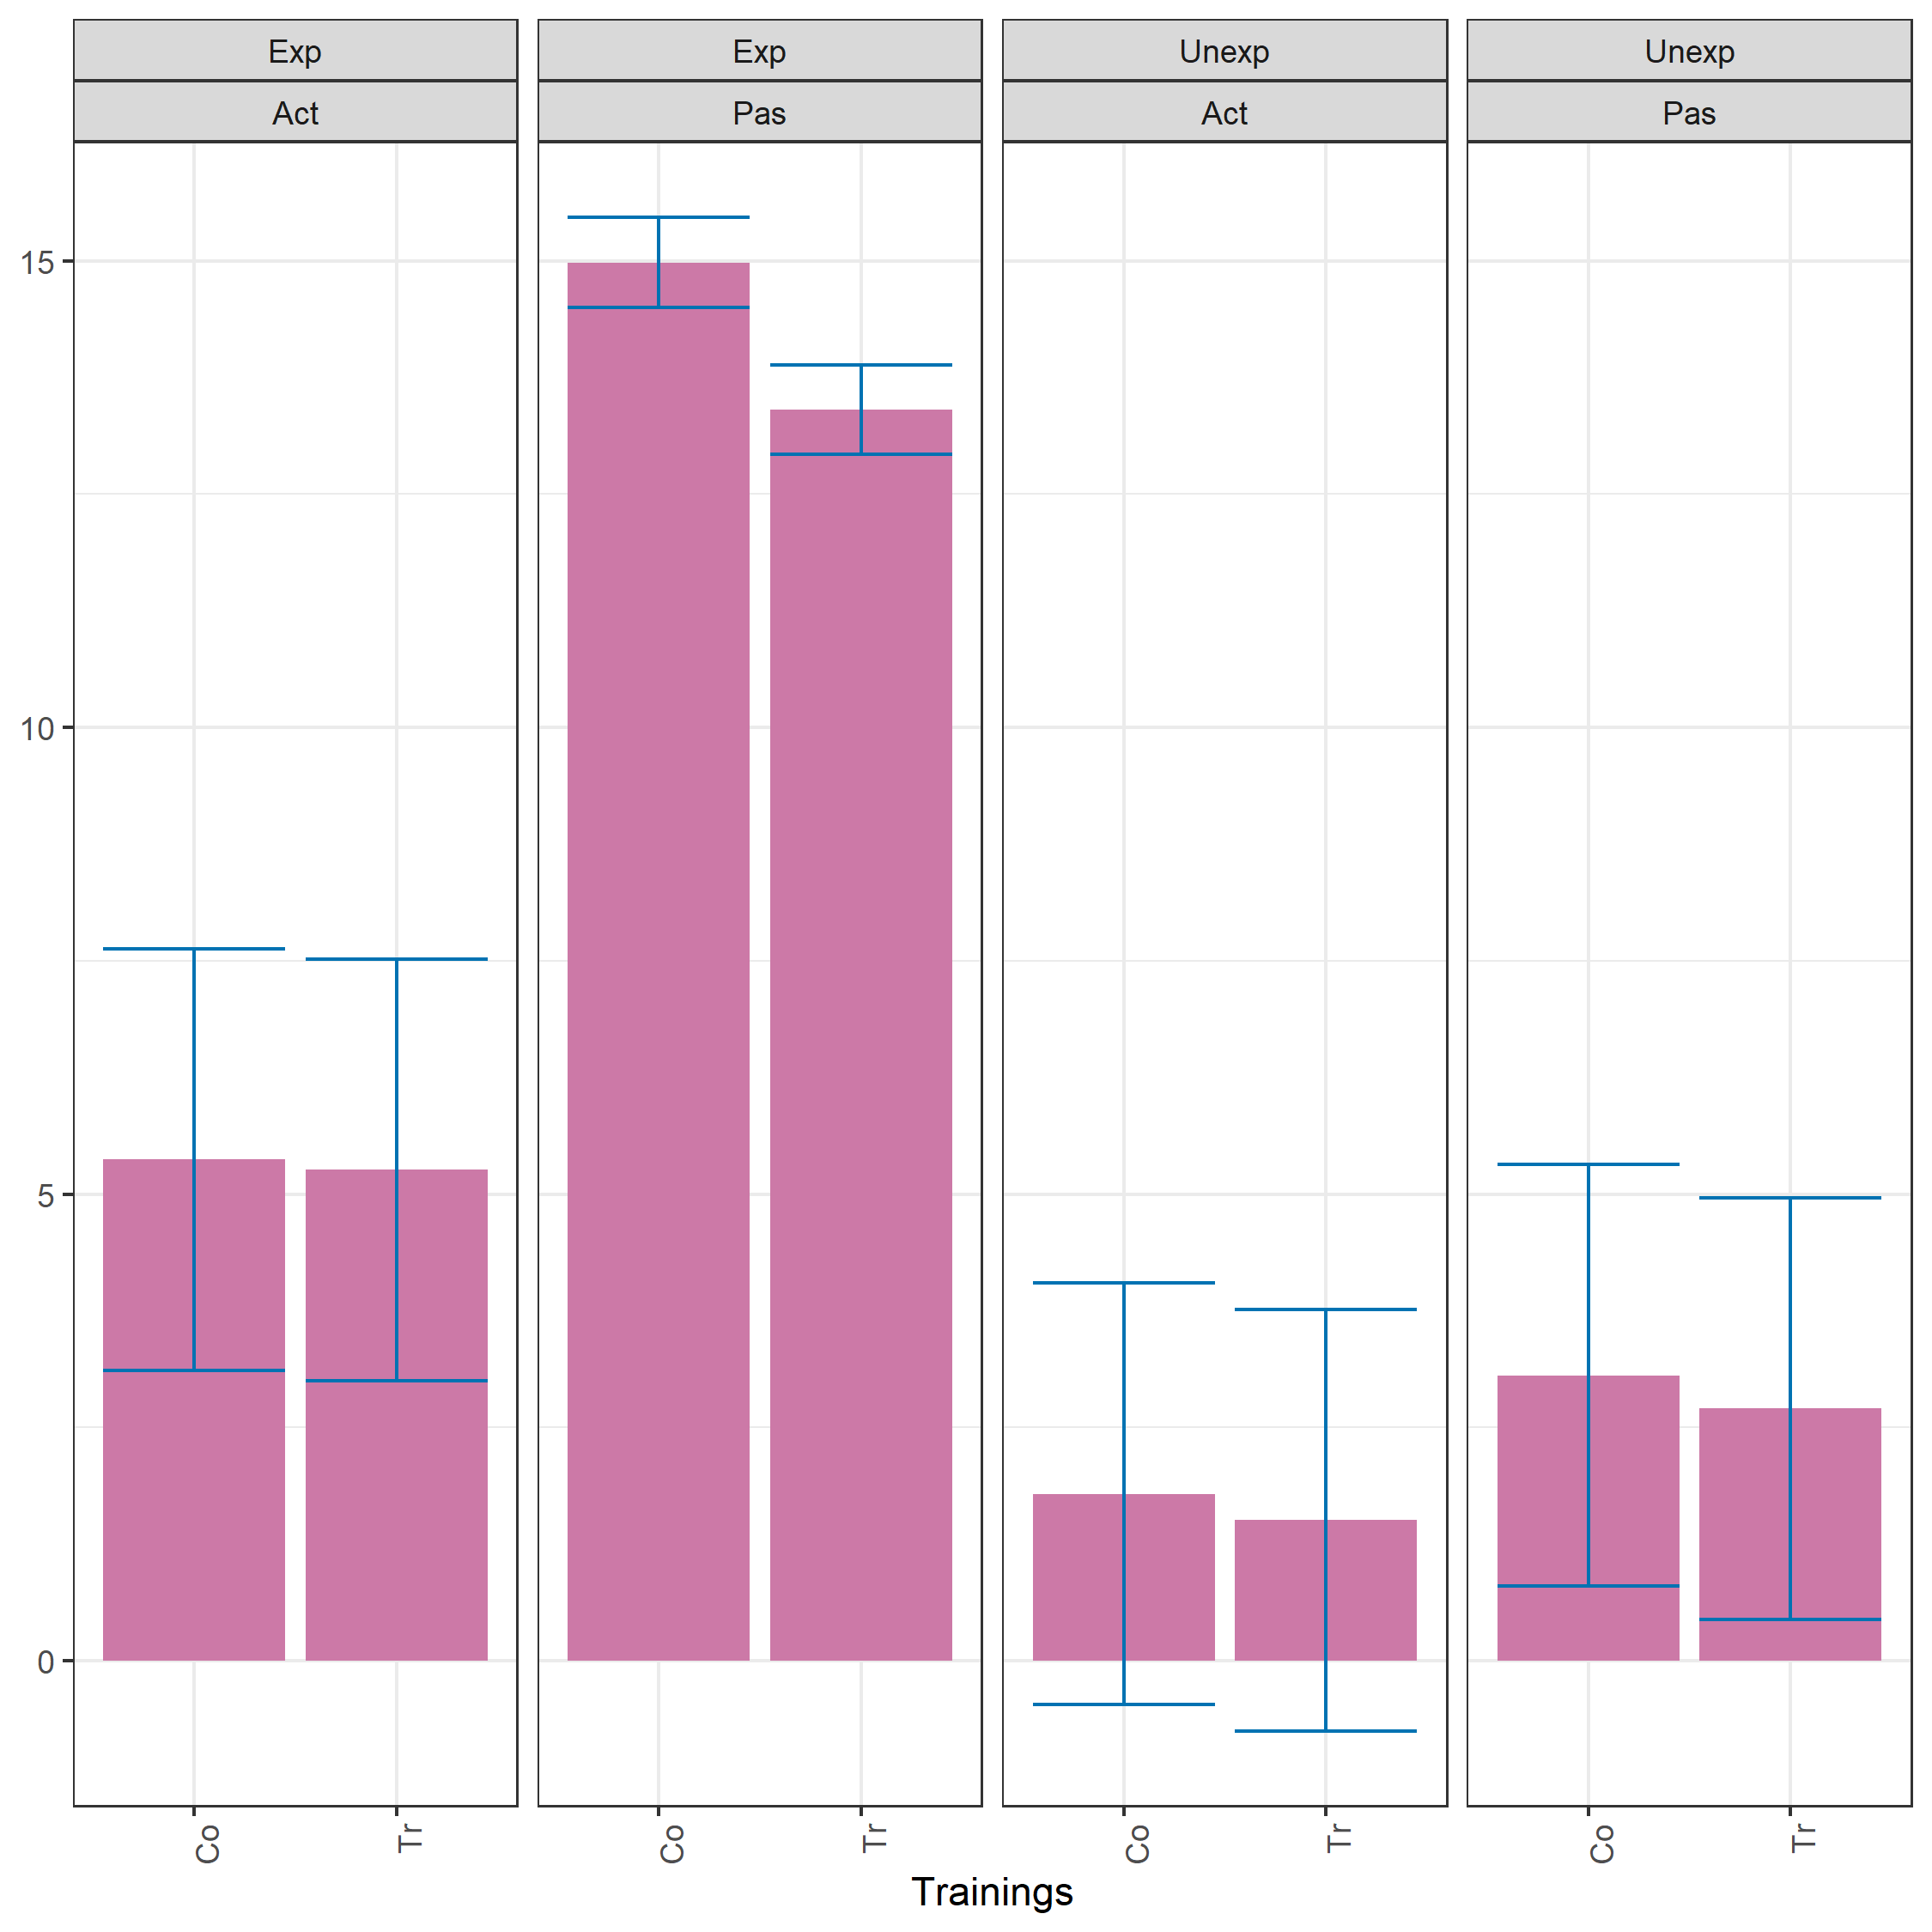
Predictions with modified overall LSIs

Slide 15
6. Conclusions
For some data, models with (i) intertier interactions and (ii) heterogeneous variances are needed.
Heterogeneous variances result in multiple LSD values that complicates the presentation of results.
The package asremlPlus has facilities to explore summary statistics of the LSDs with a view to choosing LSD values that eliminate, or at least minimize, the numbers of false conclusions.

Slide 16
References
Brien, C. J. (2022). Designing, understanding and modelling two-phase experiments with human subjects. Statistical Methods in Medical Research, 31(4), 626-645.
Brien (2022) asremlPlus: Augments 'ASReml-R' in fitting mixed models and packages generally in exploring prediction differences. Version 4.3-40. http://cran.r-project.org/package=asremlPlus/.
Butler, D. G., Cullis, B. R., Gilmour, A. R., Gogel, B. J., & Thompson, R. (2020). ASReml-R reference manual. Version 4.1.0.130. Retrieved from http://asreml.org
Farewell, V. T., & Herzberg, A. M. (2003). Plaid designs for the evaluation of training for medical practitioners. Journal of Applied Statistics, 30(9), 957-965.
Jarrett, R. G., Farewell, V. T., & Herzberg, A. M. (2020). Random effects models for complex designs. Statistical Methods in Medical Research, 29(12), 3695-3706.
Solomon, P. E., Prkachin, K. M., & Farewell, V. (1997). Enhancing sensitivity to facial expression of pain. Pain, 71(3), 279-284.
Thank you for your attention!

